Slide 1



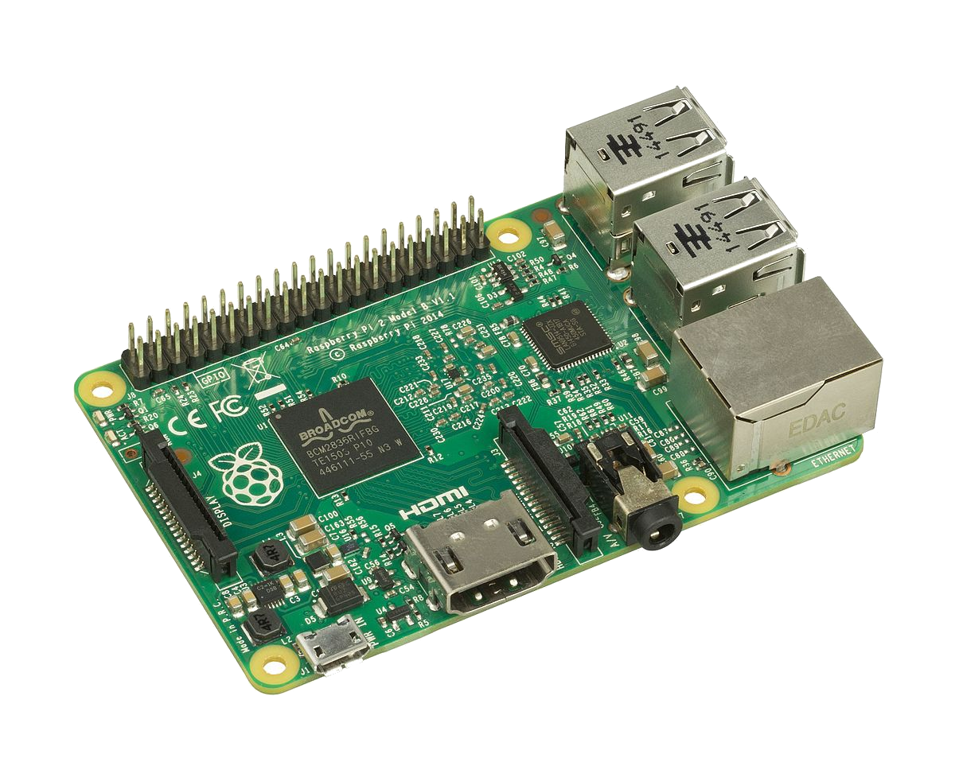
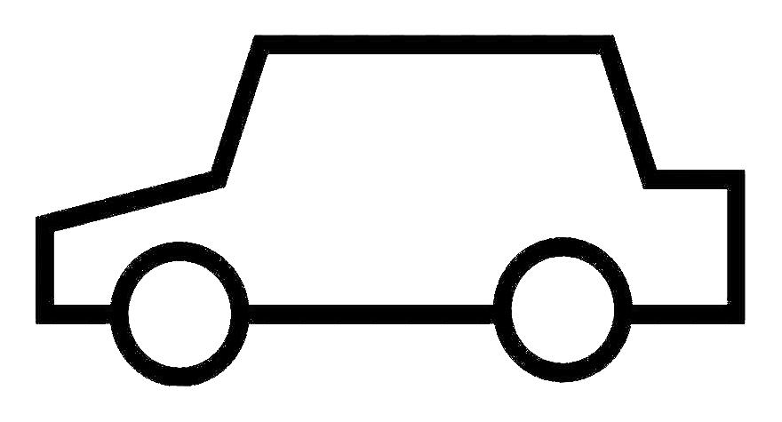

Multi-chain results
Luc Gerrits
Pr François Verdier
Using a relay-chain and two parachains

Slide 2
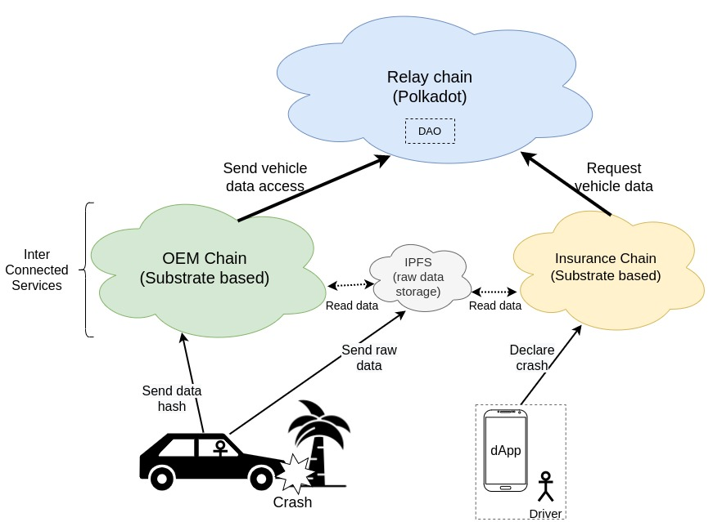
Use case

Slide 3
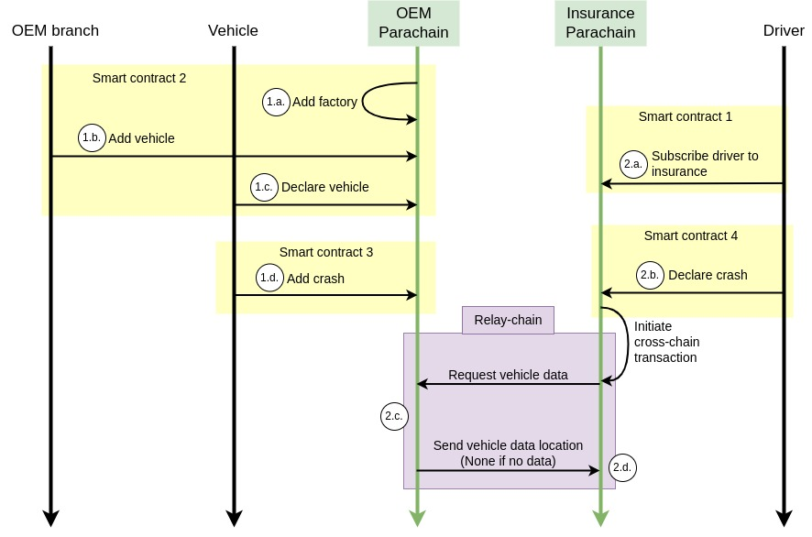
Use case interactions

Slide 4
Configuration
Cloud setup:
Relay chain: 6 validator nodes
OEM parachain: 1 to 3 collator nodes
Insurance parachain: 1 to 3 collator nodes
Test benchmark:
Deploy new cloud setup
Initialize parachains:
  10 factories inside OEM chain
  10k vehicle inside OEM chain
  10k drivers inside insurance chain
Send 10k accident reports to OEM at X TPS
Send 10k accident reports to Insurance at X TPS
Wait finish
Get blocks stats from OEM and insurance
Get number of successful cross-chain data request in insurance

Slide 5
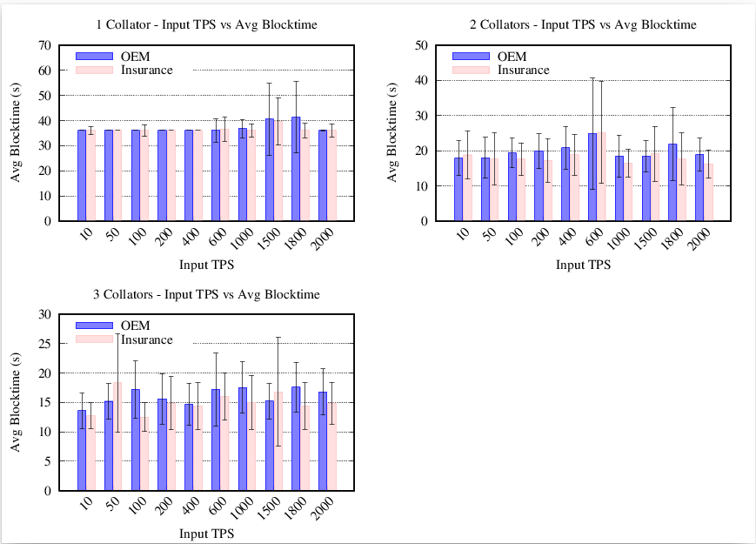
Blocktime
Target parachain blocktime => 12s
1 Collator => 35s
2 Collator => 19s
3 Collator => 15s
More collators is better...

Slide 6
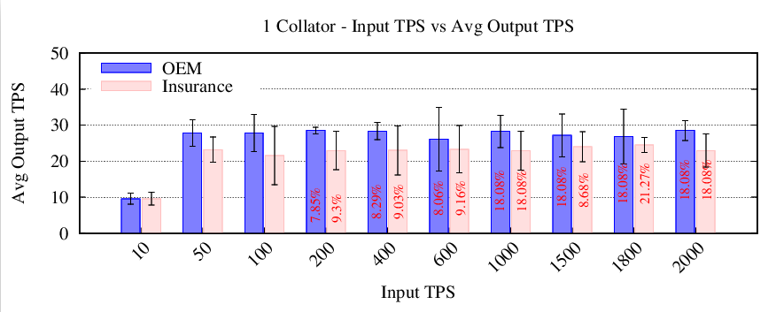
Transaction per seconds
Sending input TPS: 10, 50, 100, 200, 400, 600, 1k, 1.5k, 1.8k, 2k
Problem:
Why multiple (6 times) exactly 18.08% failed transactions ??

Slide 7
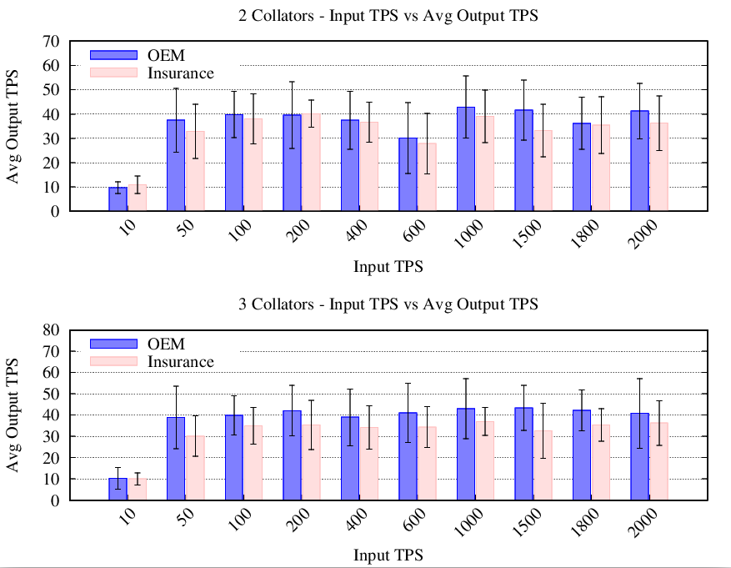
Transaction per seconds
Sending input TPS: 10, 50, 100, 200, 400, 600, 1k, 1.5k, 1.8k, 2k
Limit of ~35-40 output TPS
Always: OEM TPS higher than Insurance TPS
OEM module more simple
More collators is better...

Slide 8
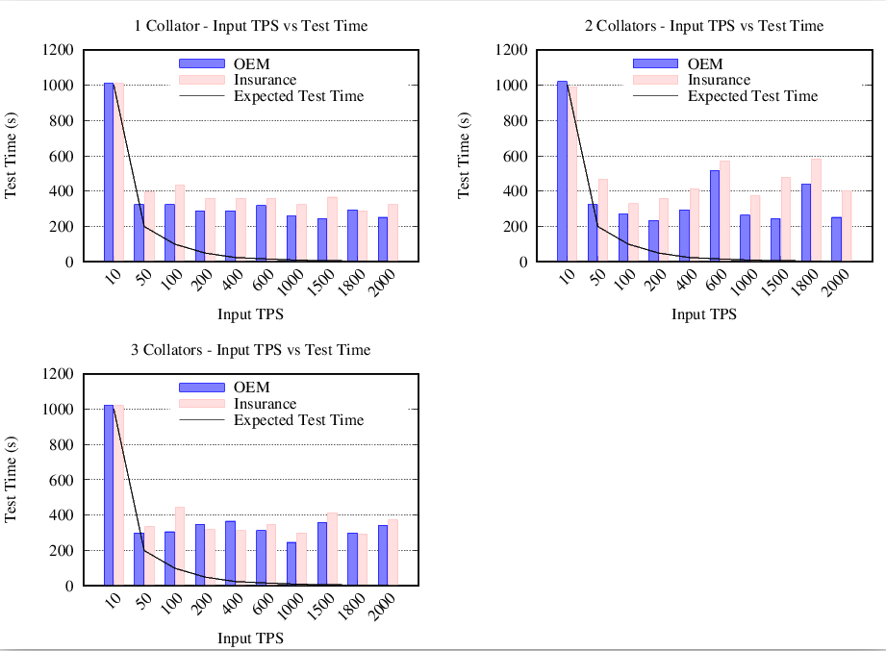
Test execution time
How long does it take to process 10k transactions ?
Independent of nb collators
Pending transaction increase with TPS
We have 35-40 output TPS:
If more input TPS...filling the pending queue

Slide 9
Questions ?

Slide 10
Reste a faire:
Regarder les data retour dans assurance
Mesure du temps d’envoie/reception d’un accident chez assurance
Pourquoi le 18% ?

